Slide 1
Advanced Artificial Intelligence
Case study on AutoEncoder
U-Net: Convolutional Networks for Biomedical Image Segmentation

Slide 2
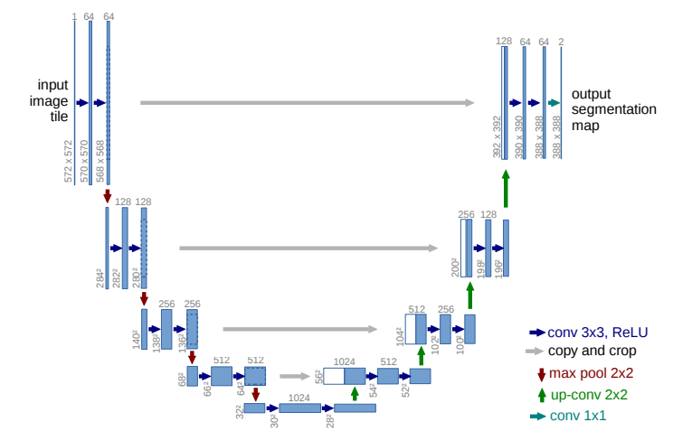
1. Why need ? 2. DO WHAT ? 3. How effective ?

Slide 3
WHY NEED ?
The typical use of convolutional networks is on classification tasks, where the output to an image is a single class label. However, in many visual tasks, especially in biomedical image processing, the desired output should include localization, i.e., a class label is supposed to be assigned to each pixel.

Slide 4
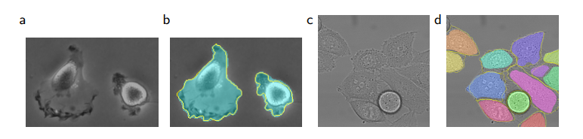
Do what ?
To do segmentation in light microscopy images.
(a) part of an input image of the “PhC-U373” data set. (b) Segmentation result (cyan mask) with manual ground truth (yellow border) (c) input image of the “DIC-HeLa” data set. (d) Segmentation result (random colored masks) with manual ground truth (yellow border).

Slide 5
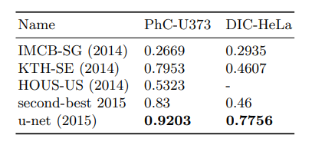
How effective ?
●The first data set “PhC-U373”2 contains Glioblastoma-astrocytoma U373 cells on a polyacrylimide substrate recorded by phase contrast microscopy. It contains 35 partially annotated training images. Here we achieve an average IOU of 92%.
●The second data set “DIC-HeLa”3 are HeLa cells on a flat glass recorded by differential interference contrast (DIC) microscopy. It contains 20 partially annotated training images. Here we achieve an average IOU of 77.5%.

